Slide 1
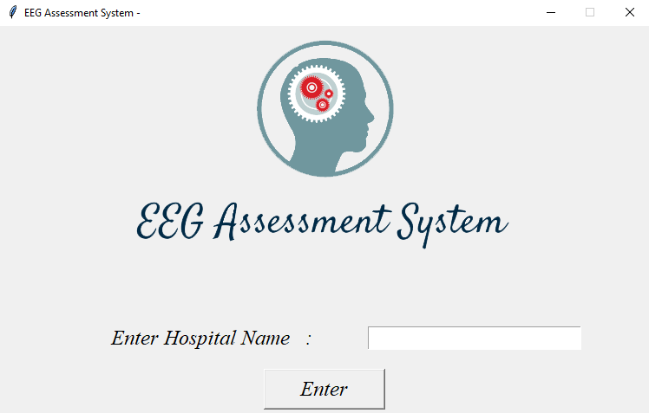
Electroencephalogram Assessment
System
Amit Kr. Mahato – 073BCT505
Dilochan Karki – 073BCT515
Dinesh Devkota – 073BCT516
Maharshi Bhusal – 073BCT522

Slide 2
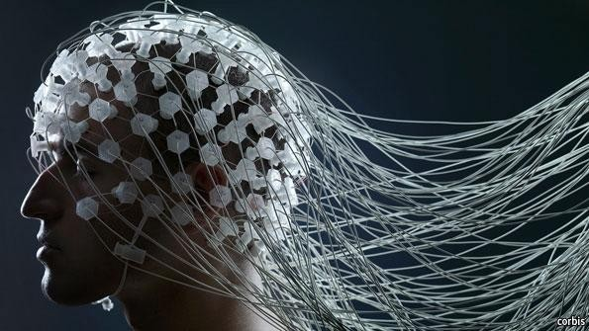
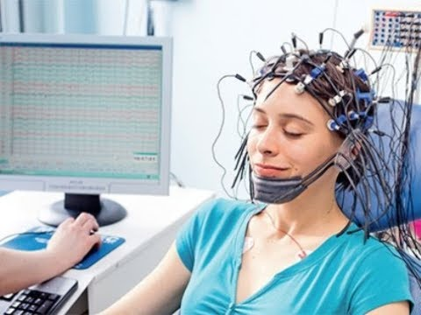
What is Brain Computer Interface(BCI)?

Slide 3
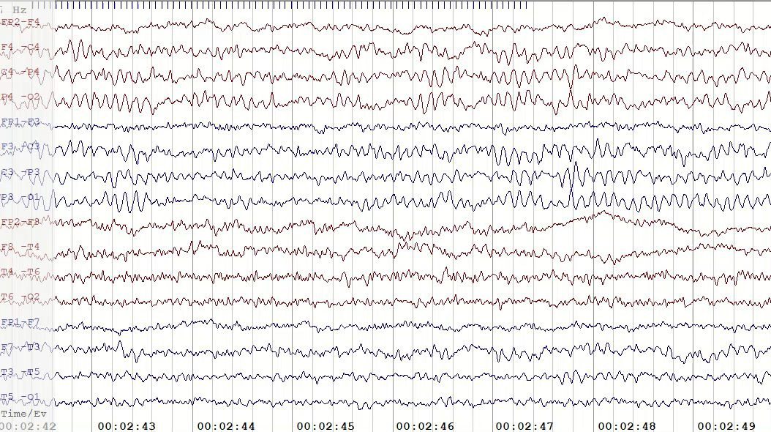
What is Electroencephalogram?

Slide 4

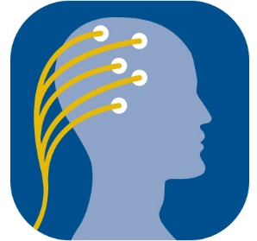

The Objective
Machine Learning
Brain Computer Interface
Notes:
Objective is combine machine learning with brain computer interface

Slide 5

Background
“... there are instances where the EEG readings were written off as seizure readings while being pure artefact readings due to movement of the body. Even with an existing system to properly study the EEG, we wish to have a system that can assess the EEG and assist the technicians. There is a need for a way to distinguish between what is a good reading and a bad reading for further diagnosis without hindrance …”
Dr. Basanta Panta
Chairman,Neurosurgeon
Annapurna Neurological Institute and Allied Sciences
​

Slide 6
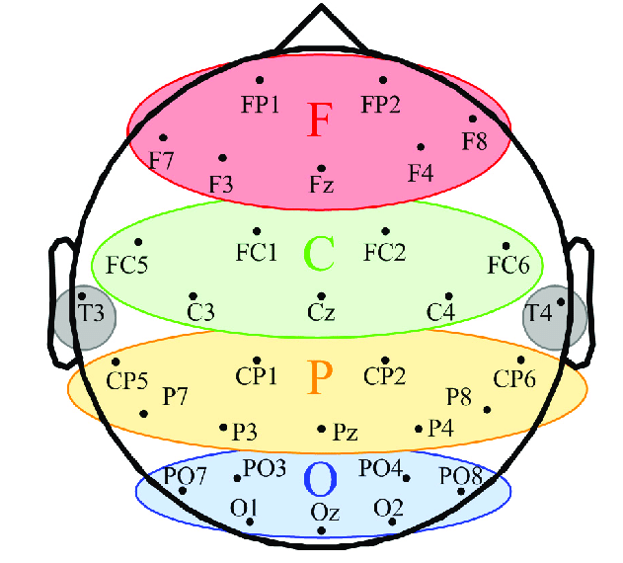
Electrode Channels
Notes:
32 channel electrode

Slide 7
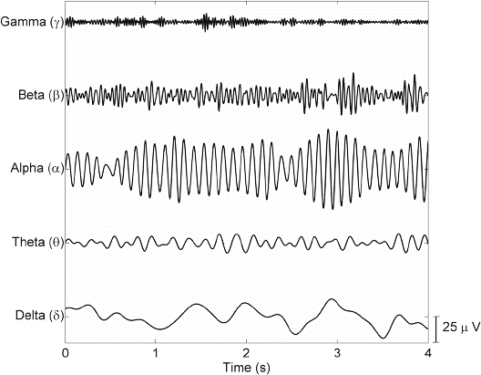
Rhythm Characteristics and Artefacts

Slide 8
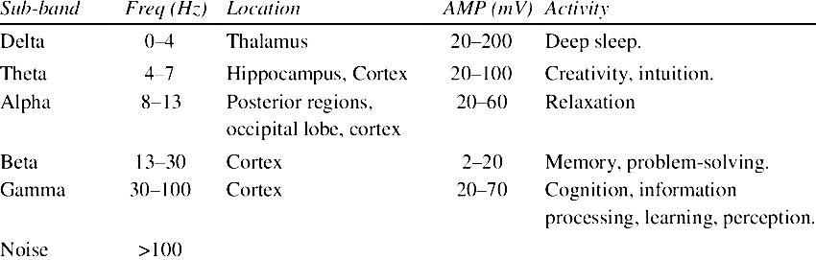

Slide 9
Field Study
Hospital Name | EEG Machine and Software | EEG Channel Format | Average EEG Time | Technician Qualification | Data Format | Data Size | Remarks
Norvic International Hospital | Neurobench version 4-32 | 19, 24 | 30 minutes | Health Assistant Registered Nurse | Excel sheets | 3-5 MB | Noise due to grounding and human errors.
Kathmandu Neuro Center and Polyclinic | Neurocompact EEG Offline | 32 | 10 mins (adult) 30 mins (child) | Registered Nurse | Printed EEG file | 1-2 MB | Noise due to electrode misplacement
Upendra Devkota Memorial National Institute Of Neurological and Allied Science | Natus Neuroworks | 32 | 12hrs, 2hrs, 1hr | Health Assistant | Printed file and soft copy of recorded EEG | 50MB - 1 GB | Noise due to grounding errors
Annapurna Neurological Institute and Allied Sciences | RMS, Natus | 16, 32 | 40mins, 1hr, 24hrs, 48hrs | Health Assistant, Bio-medical Engineers | Printed file as well as soft copy | 30MB – 2GB | Noise due to grounding and technical errors

Slide 10
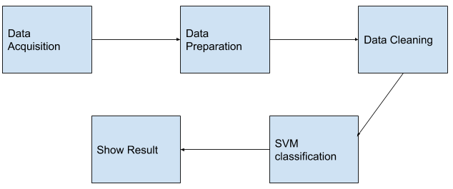
Workflow

Slide 11
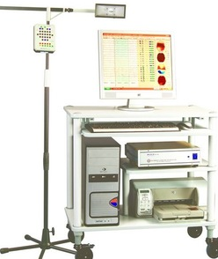
Equipment and Extension
Super Spec 32, manufactured by Recorders & Medicare Systems Pvt. Ltd (RMS).
32 Channel EEG Machine, simultaneous acquisition of raw data
Online true AC impedance check
EEG synchronous Video Recording
Automatic paging facility for quick review and analysis
Extension of files used:
.EEG- never modified, contain montage information and some other settings about original recording.
.EDF – European Data Format, standard file format designed for exchange and storage of medical time series

Slide 12



Data Preparation
RMS SuperSpec Software
Open-source Python software
RAW FILE
mne.io.read_raw_edf

Slide 13
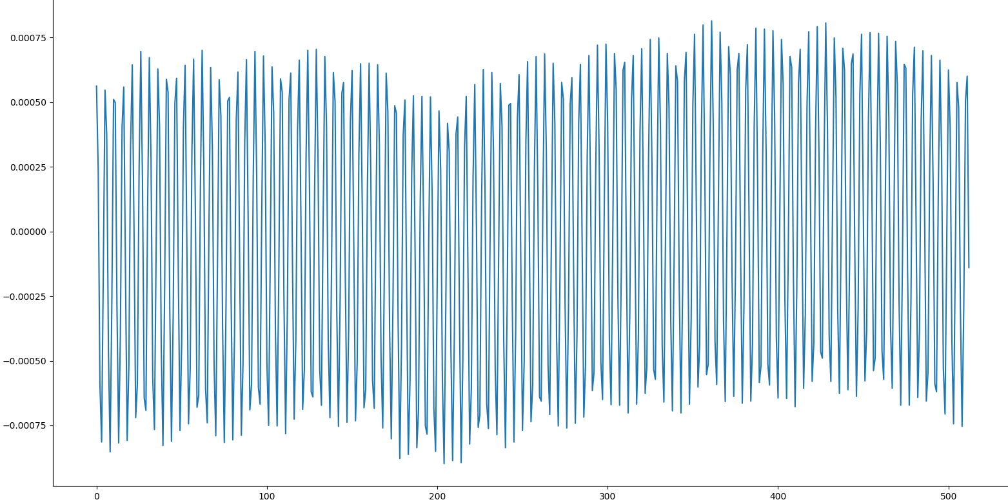
Data Processing
Notes:
Raw EEG data on a plot without any processing

Slide 14
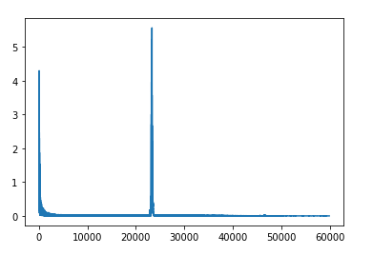
Pre-Processing Task:
Fast Fourier Transform (FFT) to decompose the set of data to be transformed into a series of smaller data sets, obtain data in frequency domain.
Electric signal slicing at 50Hz- to remove noise due to grounding and electrical interference

Slide 15
3D Mapping
3D-model synthesis focused on 16 main electrodes.
Fourier transformed again, gave amplitude of the signal at various voltages.
calculated the total voltage of the signal in alpha, beta and delta range for each second and normalized with known standard voltage.
Voltages greater than 1 were cut off at 1, negative values were also cutoff for clean color data.
Color codes for alpha, beta, and delta :Red, Green and Blue.
Data was kept in 3D array to display in the rendering engine.

Slide 16
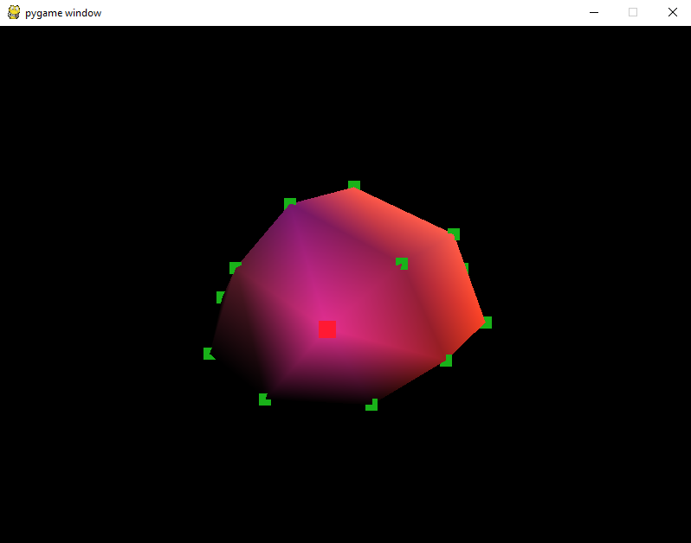
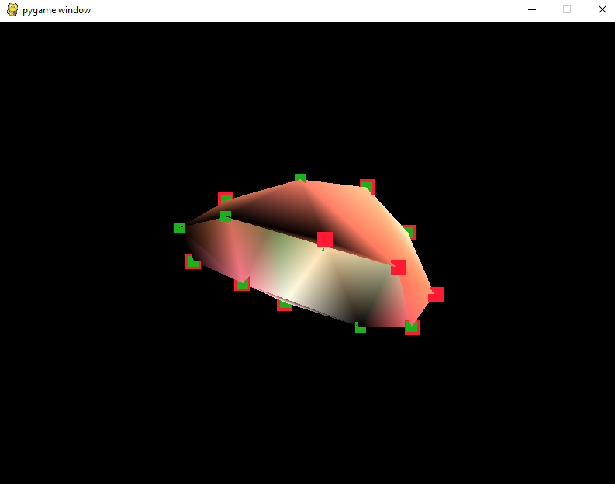
Spatial Representation of Electrodes
GREEN = Good Channel
RED = Bad Channel

Slide 17
Analysis
Area of interest was mainly three regions in frequency spectrum: delta, alpha and beta waves.
Frequency scaled by the factor f/256 where f=number of samples
Power of each frequency range calculated.
Classification required relative power of the characteristics wave, calculated by squaring the amplitude of the Fourier transform.
total of rhythmic characteristics declared as rhythmic power.
channels with the rhythmic percentage) less than 10% labelled as bad channels i.e. no adequate information of rhythmic content (*confirmed by biomedical engineers)
Notes:
i.e.6no. they did not provide adequate information to study the rhythmic content from the channel.

Slide 18
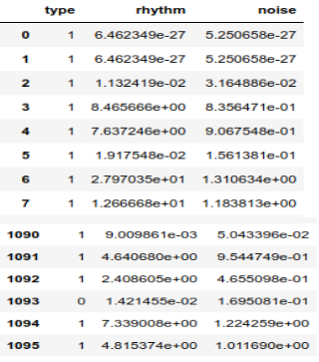
Use of Classifiers(Support Vector Machines)
Rhythmic and Artifact (noise) values used as axes for SVM classifier.
plotted the obtained data along with label used, observed linearly separable distribution of the classes of data.
used linear kernel for the SVM classifier.
opted for the value C=2⁵⁰ as the misclassification cost

Slide 19
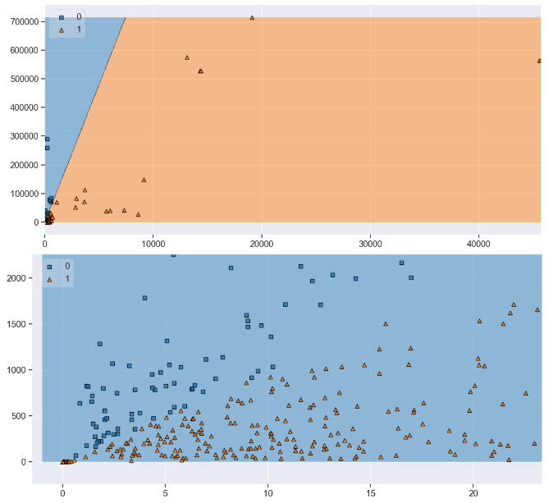

Slide 20
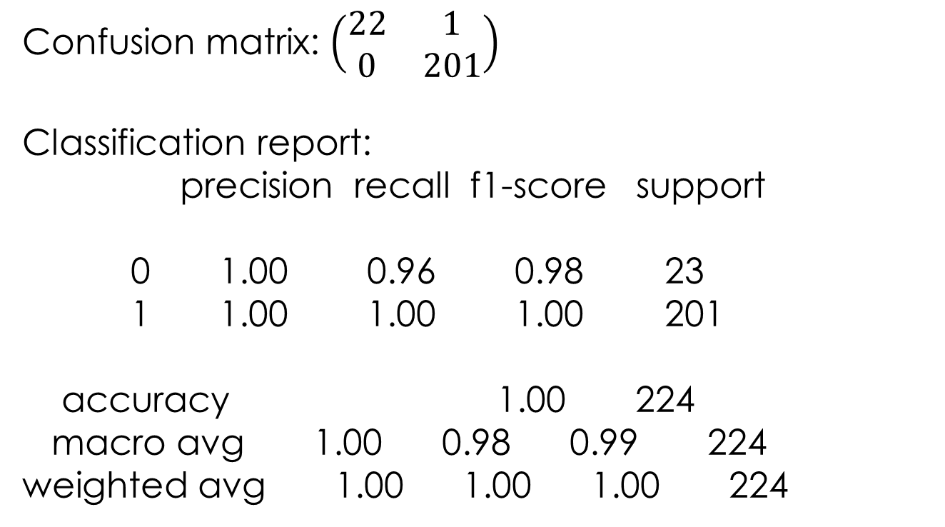
Prediction Results
Confusion matrix: $\left(\begin{matrix}22 & 1 \\ 0 & 201\end{matrix}\right)$
Classification report:
precision recall f1-score support
0 1.00 0.96 0.98 23
1 1.00 1.00 1.00 201
accuracy 1.00 224
macro avg 1.00 0.98 0.99 224
weighted avg 1.00 1.00 1.00 224
precision of 1.00 obtained for the good class and 0.99 for the bad class i.e. frequent occurrence of false positive

Slide 21
Desktop Application

Slide 22
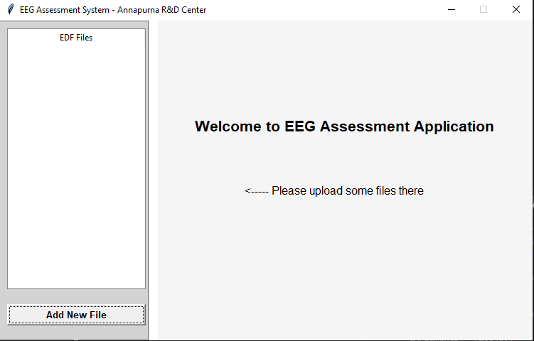

Slide 23
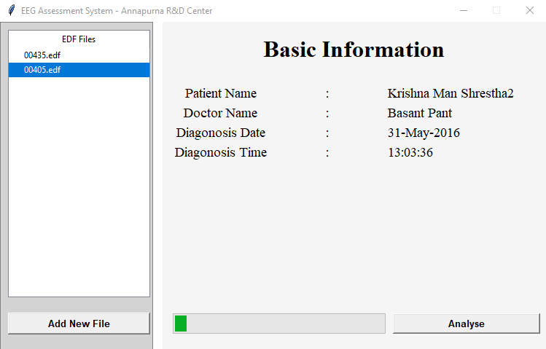

Slide 24
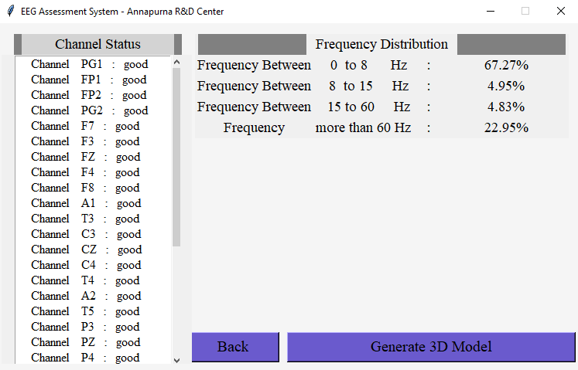

Slide 25
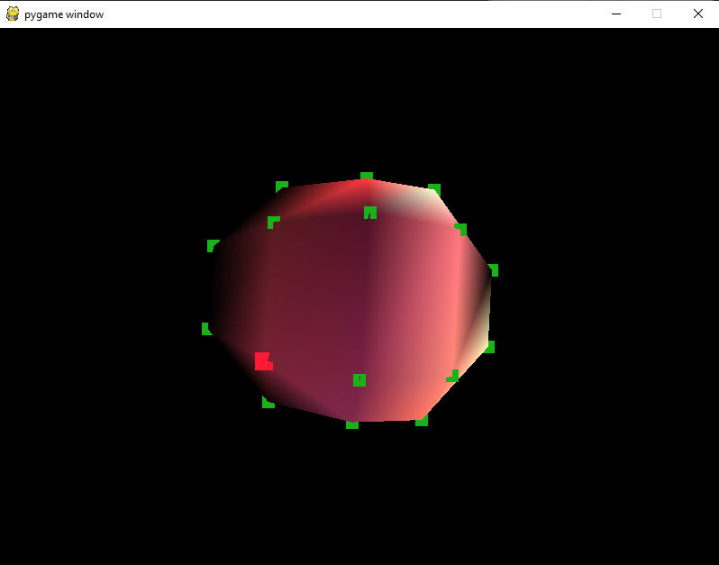
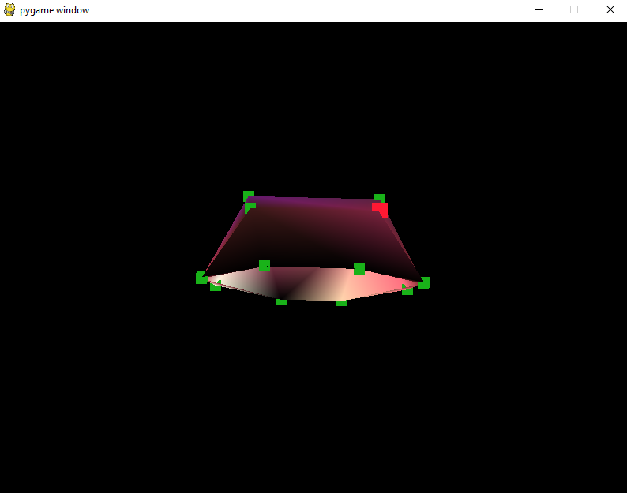
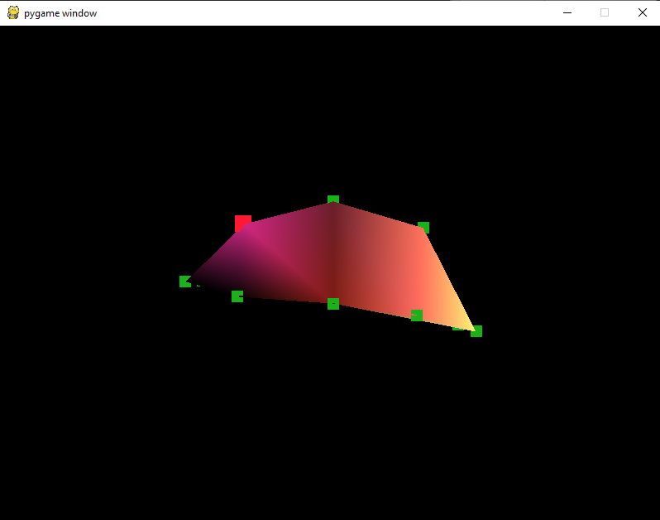

Slide 26







Technologies Used

Slide 27

Future Enhancements
Include a module to read the EEG files directly, restriction due to exclusive EEG recording software.
Additional features such as artefact removal, seizure analysis and predictions.
Make a better 3D model using better interpolation techniques.
Increase and organize the User Interface elements.

Slide 28

THANK YOU
Amit Mahato – 073BCT505
Dilochan Karki – 073BCT515
Dinesh Devkota – 073BCT516
Maharshi Bhusal – 073BCT522

